Slide 1
Optimization Refresher
CS771: Introduction to Machine Learning
Purushottam Kar

Slide 2
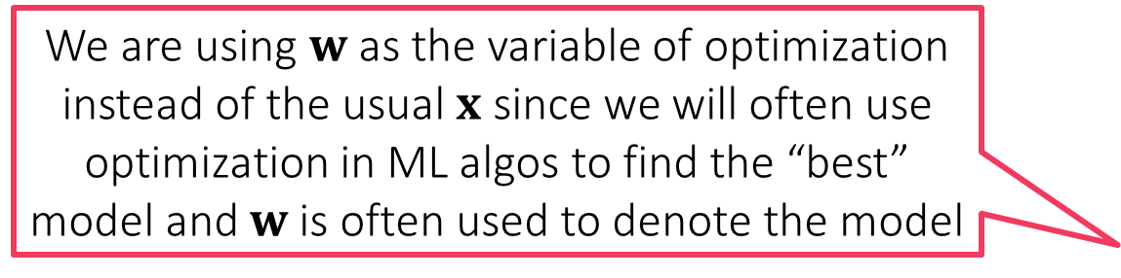
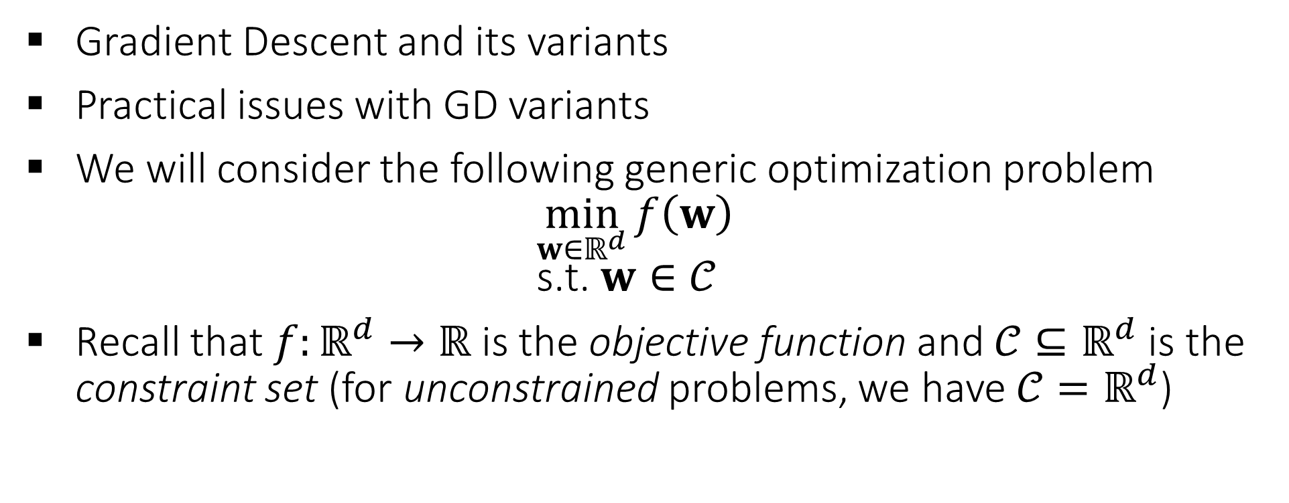
Topics to be Covered
We are using $w$ as the variable of optimization instead of the usual $x$ since we will often use optimization in ML algos to find the “best” model and $w$ is often used to denote the model
Gradient Descent and its variants
Practical issues with GD variants
We will consider the following generic optimization problem $\min_{w∈ℝ^{d}}{f\left(w\right)}$ $\text{s}\text{.}\text{t}\text{. }w∈𝒞$
Recall that $f:ℝ^{d}→ℝ$ is the objective function and $𝒞⊆ℝ^{d}$ is the constraint set (for unconstrained problems, we have $𝒞=ℝ^{d}$)

Slide 3
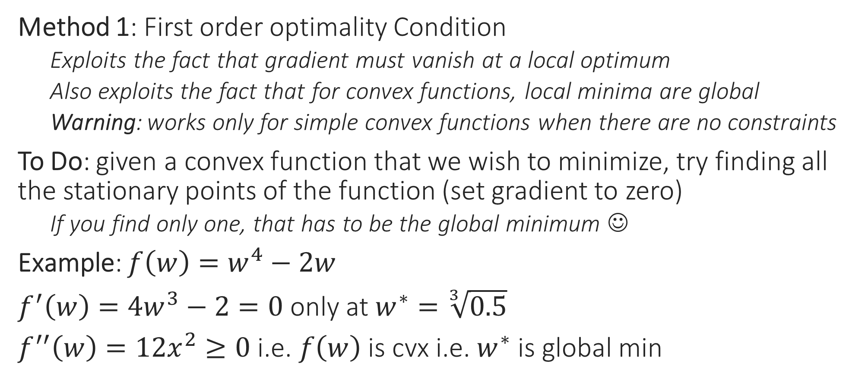
From Calculus to Optimization
Method 1: First order optimality Condition
Exploits the fact that gradient must vanish at a local optimum
Also exploits the fact that for convex functions, local minima are global
Warning: works only for simple convex functions when there are no constraints
To Do: given a convex function that we wish to minimize, try finding all the stationary points of the function (set gradient to zero)
If you find only one, that has to be the global minimum ☺
Example: $f\left(w\right)=w^{4}−2w$
$f^{′}\left(w\right)=4w^{3}−2=0$ only at $w^{∗}=\sqrt[3]{0.5}$
$f^{′′}\left(w\right)=12x^{2}≥0$ i.e. $f\left(w\right)$ is cvx i.e. $w^{∗}$ is global min

Slide 4


From Calculus to Optimization
Method 2: Perform (sub)gradient descent
Recall that direction opposite to gradient offers steepest descent
(SUB)GRADIENT DESCENT
Given: obj. func. $f:ℝ^{d}→ℝ$ to minimize
Initialize $w^{0}∈ℝ^{d}$
For $t=0, 1, …$
Obtain a (sub)gradient $g^{t}∈∂f\left(w^{t}\right)$
Choose a step length $η_{t}$
Update $w^{t+1}←w^{t}−η_{t}⋅g^{t}$
Repeat until convergence
How to initialize $w^{0}$?
How to choose $η_{t}$
Often called “step length” or “learning rate”
What is convergence?
How to decide if we have converged?

Slide 5
Gradient Descent (GD)
Choose step length carefully else may overshoot the global minimum even with great initialization
Move opposite to the gradients
Also, initialization may affect result
Our initialization was such that we converged to a local minimum
This time initialization was really nice!
Global minimum
With convex fns, all local minima are global minima and can afford to be less carefull with initialization
Still need to be careful with step lengths otherwise may overshoot global minima

Slide 6
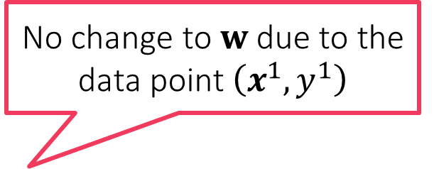
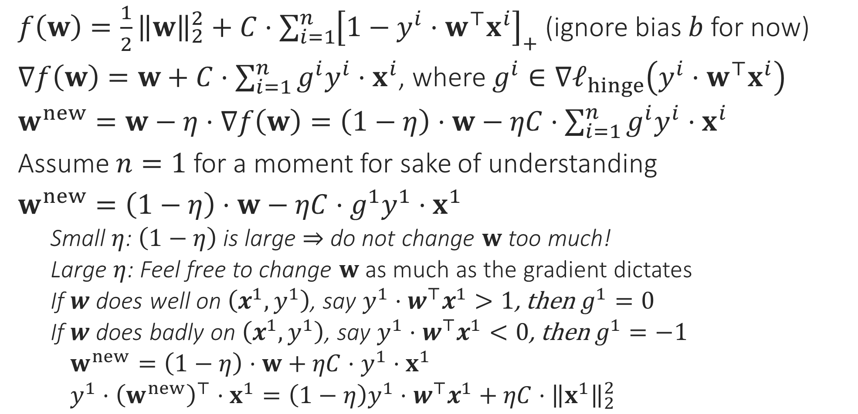
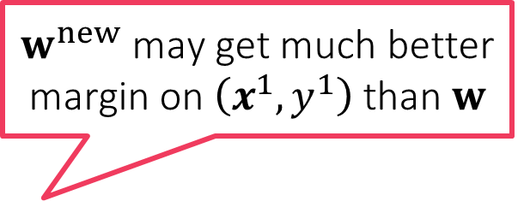
Behind the scenes in GD for SVM
So gradient descent, although a mathematical tool from calculus, actually tries very actively to make the model perform better on all data points
$f\left(w\right)=\frac{1}{2}{\left\|w\right\|}_{2}^{2}+C⋅{\sum_{i=1}^{n}{\left[1−y^{i}⋅w^{⊤}x^{i}\right]}}_{+}$ (ignore bias $b$ for now)
$∇f\left(w\right)=w+C⋅\sum_{i=1}^{n}{g^{i}y^{i}⋅x^{i}}$, where $g^{i}∈∇ℓ_{hinge}\left(y^{i}⋅w^{⊤}x^{i}\right)$
$w^{new}=w−η⋅∇f\left(w\right)=\left(1−η\right)⋅w−ηC⋅\sum_{i=1}^{n}{g^{i}y^{i}⋅x^{i}}$
Assume $n=1$ for a moment for sake of understanding
$w^{new}=\left(1−η\right)⋅w−ηC⋅g^{1}y^{1}⋅x^{1}$
Small $η$: $\left(1−η\right)$ is large $⇒$ do not change $w$ too much!
Large $η$: Feel free to change $w$ as much as the gradient dictates
If $w$ does well on $\left(x^{1},y^{1}\right)$, say $y^{1}⋅w^{⊤}x^{1}>1$, then $g^{1}=0$
If $w$ does badly on $\left(x^{1},y^{1}\right)$, say $y^{1}⋅w^{⊤}x^{1}<0$, then $g^{1}=−1$
$w^{new}=\left(1−η\right)⋅w+ηC⋅y^{1}⋅x^{1}$
$y^{1}⋅{\left(w^{new}\right)}^{⊤}⋅x^{1}={\left(1−η\right)y}^{1}⋅w^{⊤}x^{1}+ηC⋅{\left\|x^{1}\right\|}_{2}^{2}$
No change to $w$ due to the data point $\left(x^{1},y^{1}\right)$
$w^{new}$ may get much better margin on $\left(x^{1},y^{1}\right)$ than $w$

Slide 7

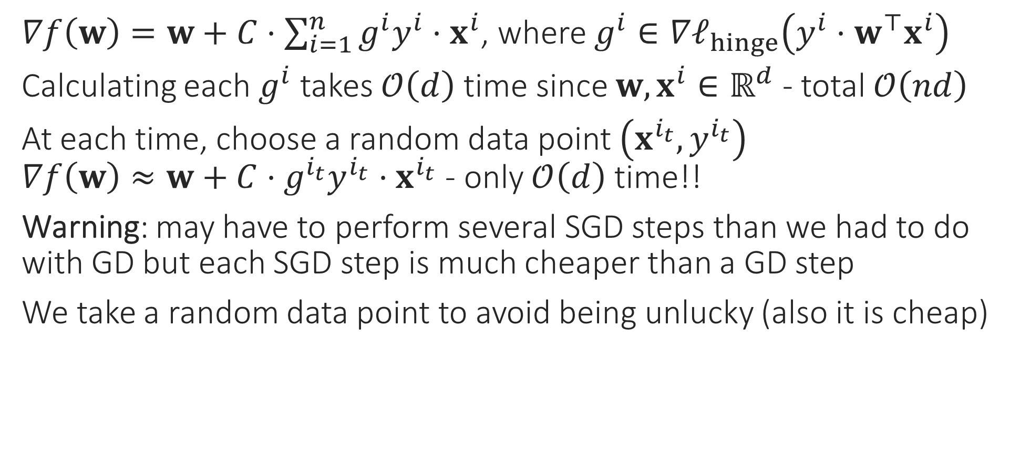
Stochastic Gradient Method
$∇f\left(w\right)=w+C⋅\sum_{i=1}^{n}{g^{i}y^{i}⋅x^{i}}$, where $g^{i}∈∇ℓ_{hinge}\left(y^{i}⋅w^{⊤}x^{i}\right)$
Calculating each $g^{i}$ takes $𝒪\left(d\right)$ time since $w,x^{i}∈ℝ^{d}$ - total $𝒪\left(nd\right)$
At each time, choose a random data point $\left(x^{i_{t}},y^{i_{t}}\right)$ $∇f\left(w\right)≈w+C⋅g^{i_{t}}y^{i_{t}}⋅x^{i_{t}}$ - only $𝒪\left(d\right)$ time!!
Warning: may have to perform several SGD steps than we had to do with GD but each SGD step is much cheaper than a GD step
We take a random data point to avoid being unlucky (also it is cheap)
Do we really need to spend so much time on just one update?
Initially, all we need is a general direction in which to move
Especially in the beginning, when we are far away from the optimum!
No, SGD gives a cheaper way to perform gradient descent

Slide 8
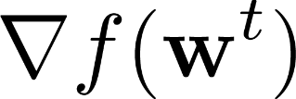
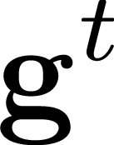
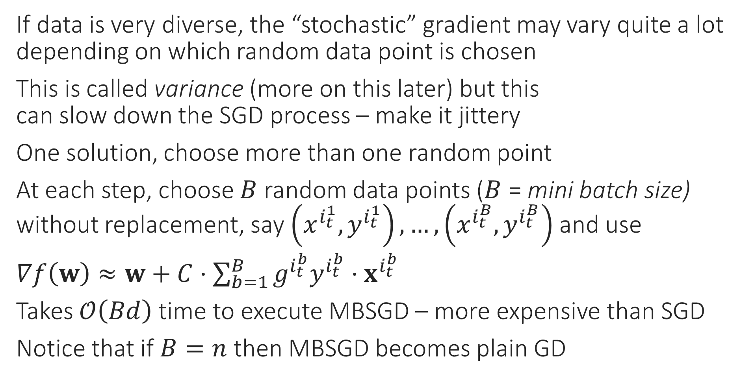
Mini-batch SGD
If data is very diverse, the “stochastic” gradient may vary quite a lot depending on which random data point is chosen
This is called variance (more on this later) but this can slow down the SGD process – make it jittery
One solution, choose more than one random point
At each step, choose $B$ random data points ($B$ = mini batch size) without replacement, say $\left(x^{i_{t}^{1}},y^{i_{t}^{1}}\right),…,\left(x^{i_{t}^{B}},y^{i_{t}^{B}}\right)$ and use
$∇f\left(w\right)≈w+C⋅\sum_{b=1}^{B}{g^{i_{t}^{b}}y^{i_{t}^{b}}⋅x^{i_{t}^{b}}}$
Takes $𝒪\left(Bd\right)$ time to execute MBSGD – more expensive than SGD
Notice that if $B=n$ then MBSGD becomes plain GD

Slide 9
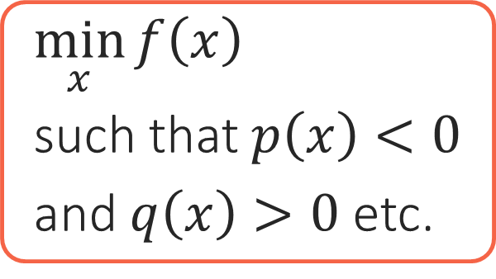
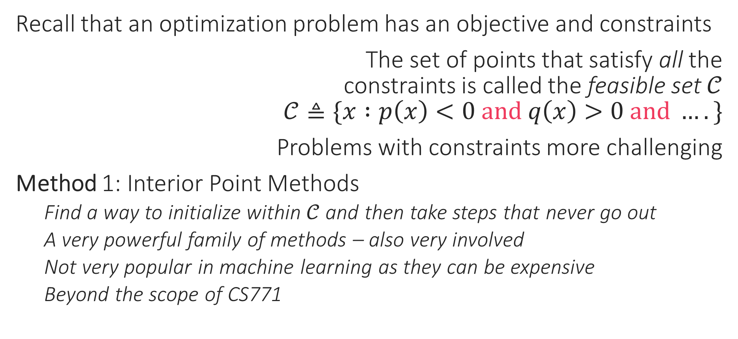
Constrained Optimization
Recall that an optimization problem has an objective and constraints
The set of points that satisfy all the constraints is called the feasible set $𝒞$ $𝒞≜\{x :p\left(x\right)<0 and q\left(x\right)>0 and ….\}$
Problems with constraints more challenging
Method 1: Interior Point Methods
Find a way to initialize within $𝒞$ and then take steps that never go out
A very powerful family of methods – also very involved
Not very popular in machine learning as they can be expensive
Beyond the scope of CS771
Objective
Constraints
$\min_{x}{f\left(x\right)}$
such that $p\left(x\right)<0$
and $q\left(x\right)>0$ etc.

Slide 10




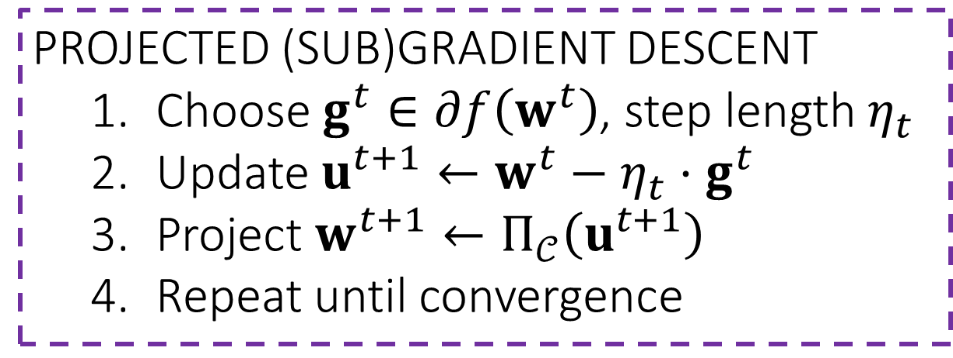
Constrained Optimization
Method 2: Projected Gradient Descent
Perform (stochastic) gradient descent as usual. However, if this causes us to step outside the feasible set $𝒞$, go back to the feasible set
Process of “going back” into $𝒞$: projection step $\hat{x}=Π_{𝒞}\left(x\right)=\arg{\min_{z∈𝒞}{{\left\|x−z\right\|}_{2}^{2}}}$
Warning: works only if $𝒞$ is such that projection step is easy
PROJECTED (SUB)GRADIENT DESCENT
Choose $g^{t}∈∂f\left(w^{t}\right)$, step length $η_{t}$
Update $u^{t+1}←w^{t}−η_{t}⋅g^{t}$
Project $w^{t+1}←Π_{𝒞}\left(u^{t+1}\right)$
Repeat until convergence
Projection

Slide 11
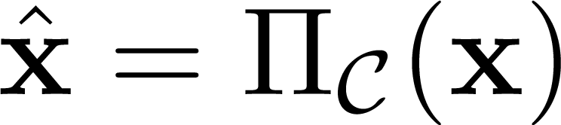
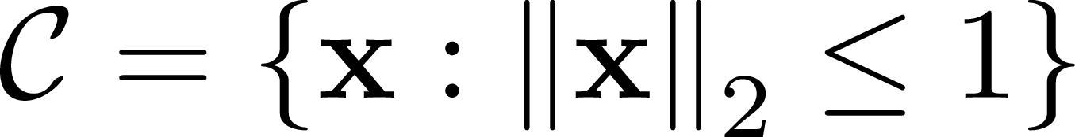

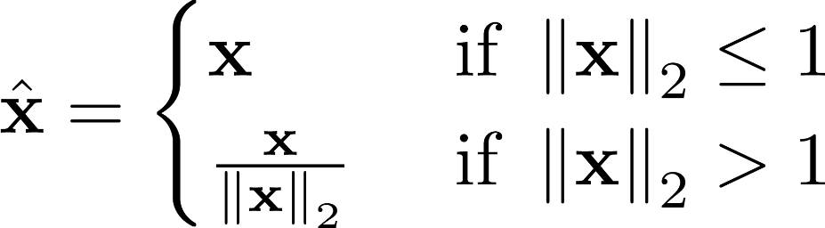
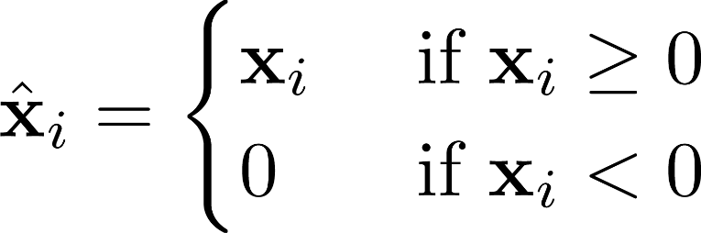
A few useful Projections

Slide 12

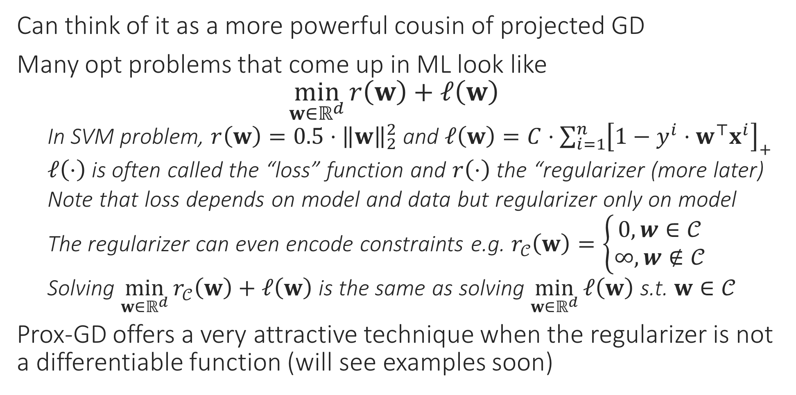
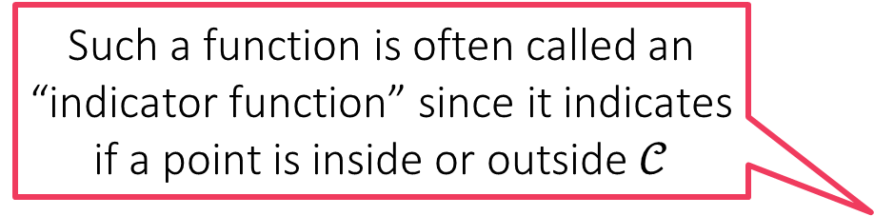

Proximal Gradient Descent
Can think of it as a more powerful cousin of projected GD
Many opt problems that come up in ML look like $\min_{w∈ℝ^{d}}{r\left(w\right)+ℓ\left(w\right)}$
In SVM problem, $r\left(w\right)=0.5⋅{\left\|w\right\|}_{2}^{2}$ and $ℓ\left(w\right)=C⋅{\sum_{i=1}^{n}{\left[1−y^{i}⋅w^{⊤}x^{i}\right]}}_{+}$
$ℓ\left(⋅\right)$ is often called the “loss” function and $r\left(⋅\right)$ the “regularizer (more later)
Note that loss depends on model and data but regularizer only on model
The regularizer can even encode constraints e.g. $r_{𝒞}\left(w\right)=\left\{\begin{aligned}0,w∈𝒞 \\ ∞,w∉𝒞\end{aligned}\right.$
Solving $\min_{w∈ℝ^{d}}{r_{𝒞}\left(w\right)+ℓ\left(w\right)}$ is the same as solving $\min_{w∈ℝ^{d}}{ℓ\left(w\right)}$ s.t. $w∈𝒞$
Prox-GD offers a very attractive technique when the regularizer is not a differentiable function (will see examples soon)
$$r_{𝒞}$$
$$𝒞$$
Such a function is often called an “indicator function” since it indicates if a point is inside or outside $𝒞$

Slide 13

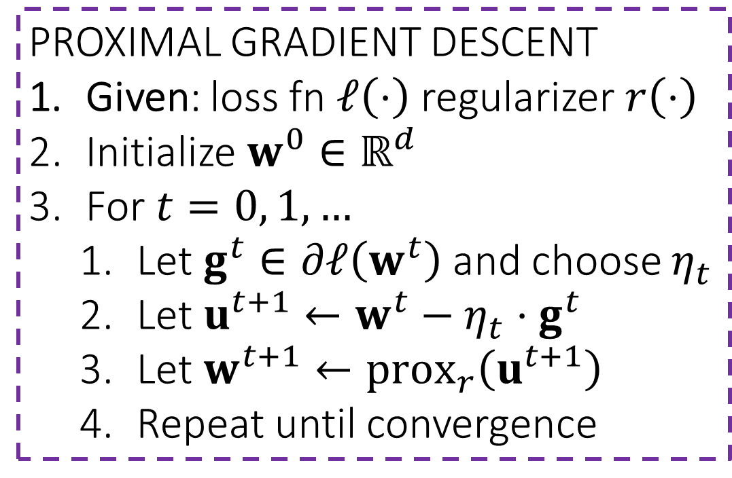



Proximal Gradient Descent
The intuition behind this definition is that we wish to stay in the proximity of the input $u$, but also lower 𝑟(⋅) value
For any function $r\left(⋅\right)$ define the proximal function as
$${prox}_{r}\left(u\right)=\arg{\min_{z}\left[r\left(z\right)+\frac{1}{2}{\left\|z−u\right\|}_{2}^{2}\right]}$$
Nice! So the prox step is trying to lower 𝑟(⋅) value without undoing progress made by gradient step
Indeed – prox GD is very useful for problems where regularizer is non-differentiable
PROXIMAL GRADIENT DESCENT
Given: loss fn $ℓ\left(⋅\right)$ regularizer $r\left(⋅\right)$
Initialize $w^{0}∈ℝ^{d}$
For $t=0, 1, …$
Let $g^{t}∈∂ℓ\left(w^{t}\right)$ and choose $η_{t}$
Let $u^{t+1}←w^{t}−η_{t}⋅g^{t}$
Let $w^{t+1}←prox_{r}\left(u^{t+1}\right)$
Repeat until convergence
If $r\left(⋅\right)$ is indicator fn of a set $𝒞$, proxGD becomes projected GD ${prox}_{r}\left(u\right)=\arg{\min_{z∈𝓒}{{\left\|u−z\right\|}_{2}}}$
If $r\left(w\right)=0.5⋅{\left\|w\right\|}_{2}^{2}$ then $prox_{r}\left(u\right)=u/2$ i.e. scaling
ProxGD very useful in learning sparse models which are offer smaller model size, test times

Slide 14

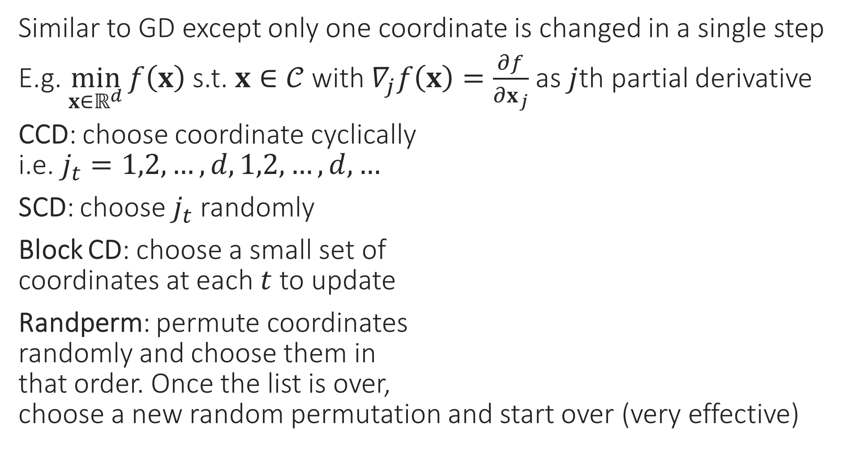
Coordinate Descent
Sometimes we are able to optimize completely along a given variable (even if constraints are there) – called coordinate minimization (CM)
Similar to GD except only one coordinate is changed in a single step
E.g. $\min_{x∈ℝ^{d}}{f\left(x\right)}$ s.t. $x∈𝒞$ with $∇_{j}f\left(x\right)=\frac{∂f}{∂x_{j}}$ as $j$th partial derivative
CCD: choose coordinate cyclically i.e. $j_{t}=1,2,…,d,1,2,…,d,…$
SCD: choose $j_{t}$ randomly
Block CD: choose a small set of coordinates at each $t$ to update
Randperm: permute coordinates randomly and choose them in that order. Once the list is over, choose a new random permutation and start over (very effective)
(PROJECTED) COORDINATE DESCENT
1. For $t=0,1,…$
Select a coordinate $j_{t}∈\left[d\right]$
Let $u_{j_{t}}^{t+1}←x_{j_{t}}^{t}−η_{t}⋅∇_{j_{t}}f\left(x^{t}\right)$
Let $u_{j}^{t+1}←x_{j}^{t}$ for $j≠j_{t}$
Project $x^{t+1}←Π_{𝒞}\left(u^{t+1}\right)$
Repeat until convergence

Slide 15
Practical Issues with GD Variants
How to initialize?
How to decide convergence?
How to decide step lengths?

Slide 16
How to Initialize?
Initializing close to the global optimum is obviously preferable ☺
Easier said than done. In some applications however, we may have such initialization e.g. someone may have a model they trained on different data
For convex functions, bad initialization may mean slow convergence, but if step lengths are nice then GD should converge eventually
For non-convex functions (e.g. while training deepnets), bad initialization may mean getting stuck at a very bad saddle point
Random restarts most common solution to overcome this problem
For some nice non-convex problems, we do know very good ways to provably initialize close to the global optimum (e.g. collaborative filtering in recommendation systems) – details beyond scope of CS771

Slide 17
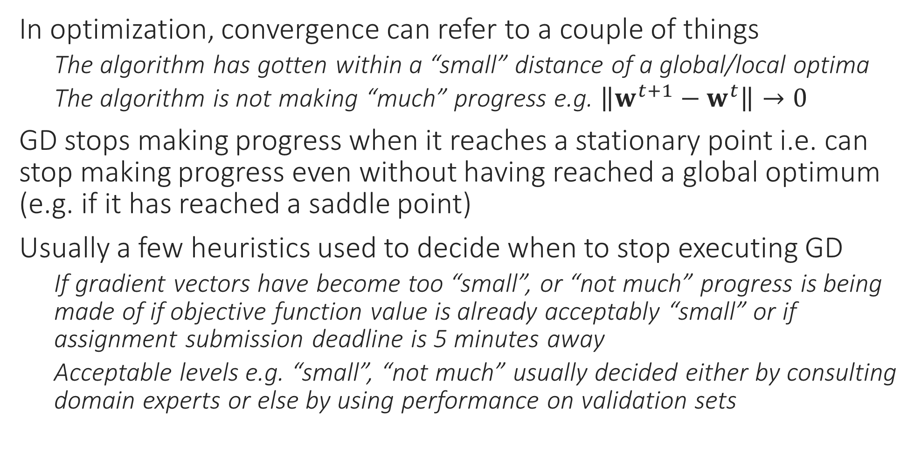
How to decide Convergence?
In optimization, convergence can refer to a couple of things
The algorithm has gotten within a “small” distance of a global/local optima
The algorithm is not making “much” progress e.g. $\left\|w^{t+1}−w^{t}\right\|→0$
GD stops making progress when it reaches a stationary point i.e. can stop making progress even without having reached a global optimum (e.g. if it has reached a saddle point)
Usually a few heuristics used to decide when to stop executing GD
If gradient vectors have become too “small”, or “not much” progress is being made of if objective function value is already acceptably “small” or if assignment submission deadline is 5 minutes away
Acceptable levels e.g. “small”, “not much” usually decided either by consulting domain experts or else by using performance on validation sets

Slide 18
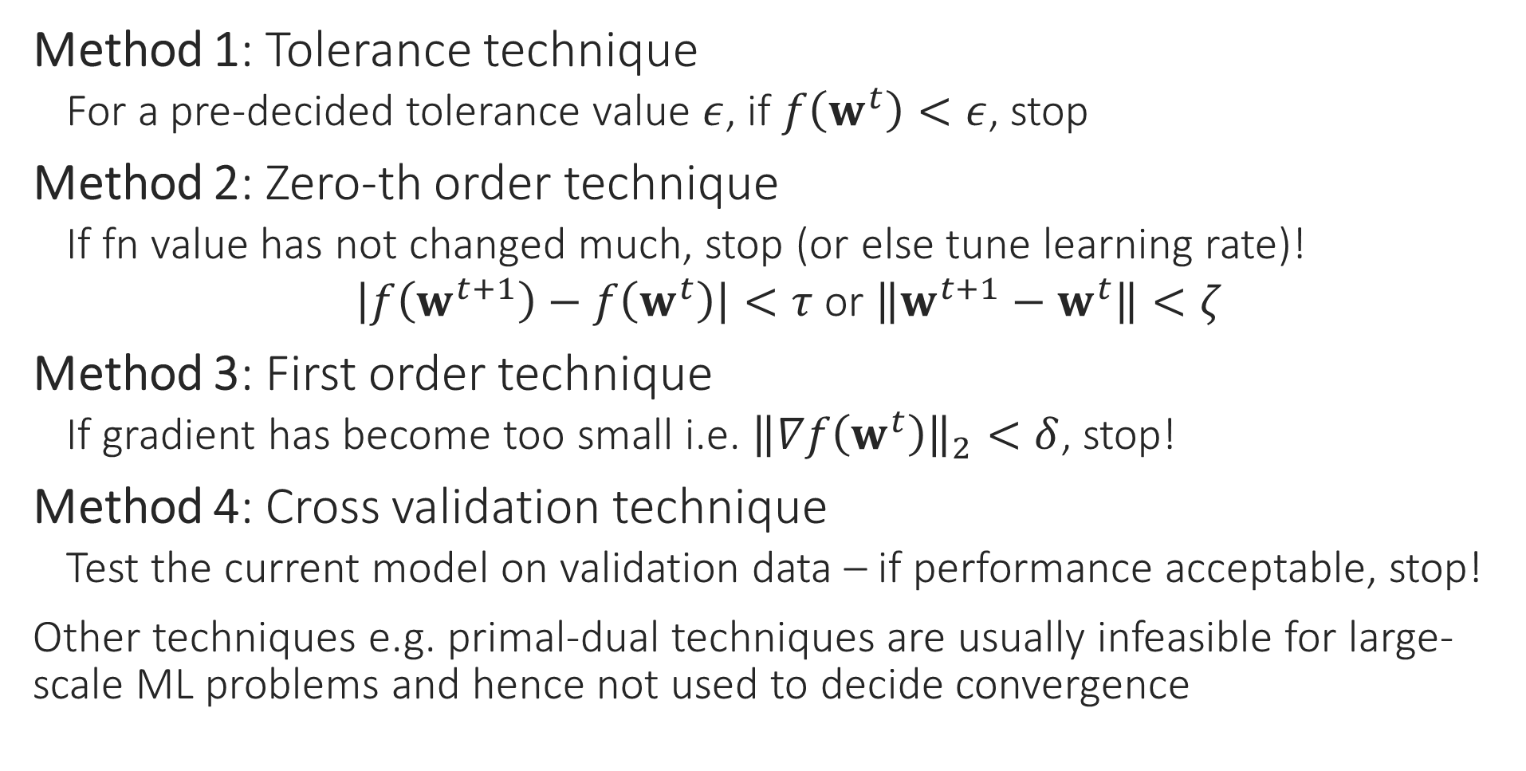
How to detect convergence
Method 1: Tolerance technique
For a pre-decided tolerance value $ε$, if $f\left(w^{t}\right)<ε$, stop
Method 2: Zero-th order technique
If fn value has not changed much, stop (or else tune learning rate)!
$\left|f\left(w^{t+1}\right)−f\left(w^{t}\right)\right|<τ$ or $\left\|w^{t+1}−w^{t}\right\|<ζ$
Method 3: First order technique
If gradient has become too small i.e. ${\left\|∇f\left(w^{t}\right)\right\|}_{2}<δ$, stop!
Method 4: Cross validation technique
Test the current model on validation data – if performance acceptable, stop!
Other techniques e.g. primal-dual techniques are usually infeasible for large-scale ML problems and hence not used to decide convergence

Slide 19
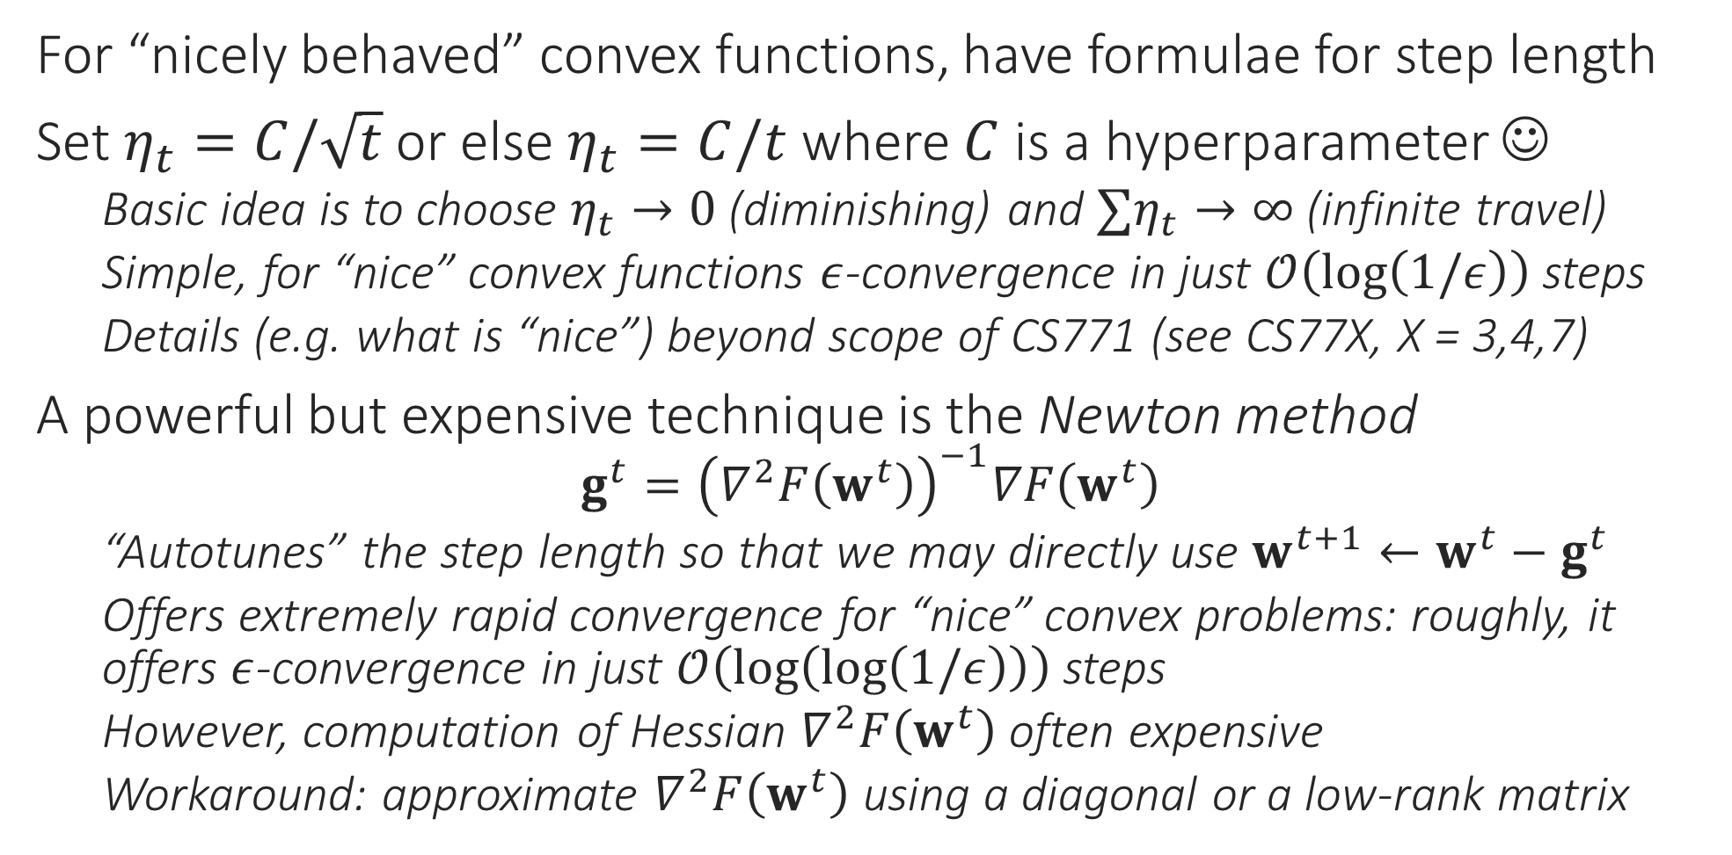
How to choose Step Length?
For “nicely behaved” convex functions, have formulae for step length
Set $η_{t}=C/\sqrt{t}$ or else $η_{t}=C/t$ where $C$ is a hyperparameter ☺
Basic idea is to choose $η_{t}→0$ (diminishing) and $∑η_{t}→∞$ (infinite travel)
Simple, for “nice” convex functions $ε$-convergence in just $𝒪\left(\log\left(1/ε\right)\right)$ steps
Details (e.g. what is “nice”) beyond scope of CS771 (see CS77X, X = 3,4,7)
A powerful but expensive technique is the Newton method
$$g^{t}={\left(∇^{2}F\left(w^{t}\right)\right)}^{−1}∇F\left(w^{t}\right)$$
“Autotunes” the step length so that we may directly use $w^{t+1}←w^{t}−g^{t}$
Offers extremely rapid convergence for “nice” convex problems: roughly, it offers $ε$-convergence in just $𝒪\left(\log\left(\log\left(1/ε\right)\right)\right)$ steps
However, computation of Hessian $∇^{2}F\left(w^{t}\right)$ often expensive
Workaround: approximate $∇^{2}F\left(w^{t}\right)$ using a diagonal or a low-rank matrix

Slide 20
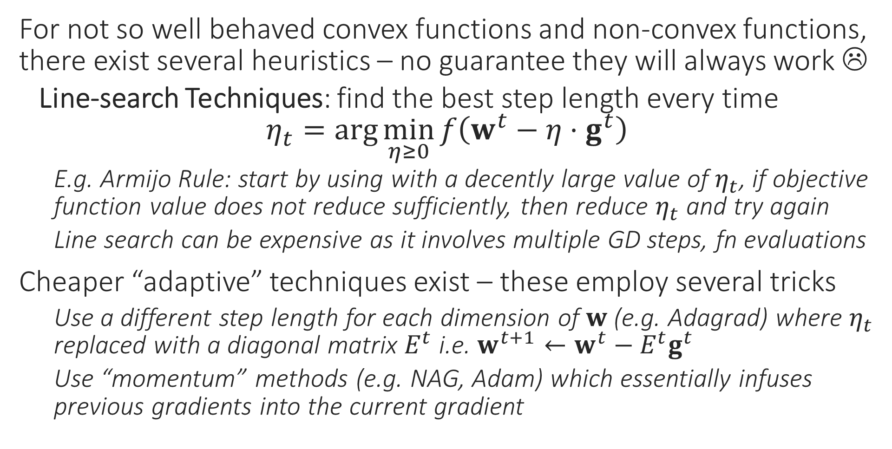
How to choose Step Length?
For not so well behaved convex functions and non-convex functions, there exist several heuristics – no guarantee they will always work ☹
Line-search Techniques: find the best step length every time $η_{t}=\arg{\min_{η≥0}{f\left(w^{t}−η⋅g^{t}\right)}}$
E.g. Armijo Rule: start by using with a decently large value of $η_{t}$, if objective function value does not reduce sufficiently, then reduce $η_{t}$ and try again
Line search can be expensive as it involves multiple GD steps, fn evaluations
Cheaper “adaptive” techniques exist – these employ several tricks
Use a different step length for each dimension of $w$ (e.g. Adagrad) where $η_{t}$ replaced with a diagonal matrix $E^{t}$ i.e. $w^{t+1}←w^{t}−E^{t}g^{t}$
Use “momentum” methods (e.g. NAG, Adam) which essentially infuses previous gradients into the current gradient

Slide 21

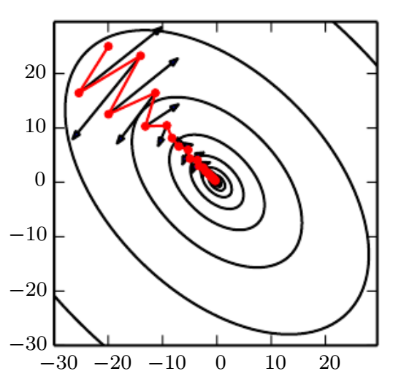
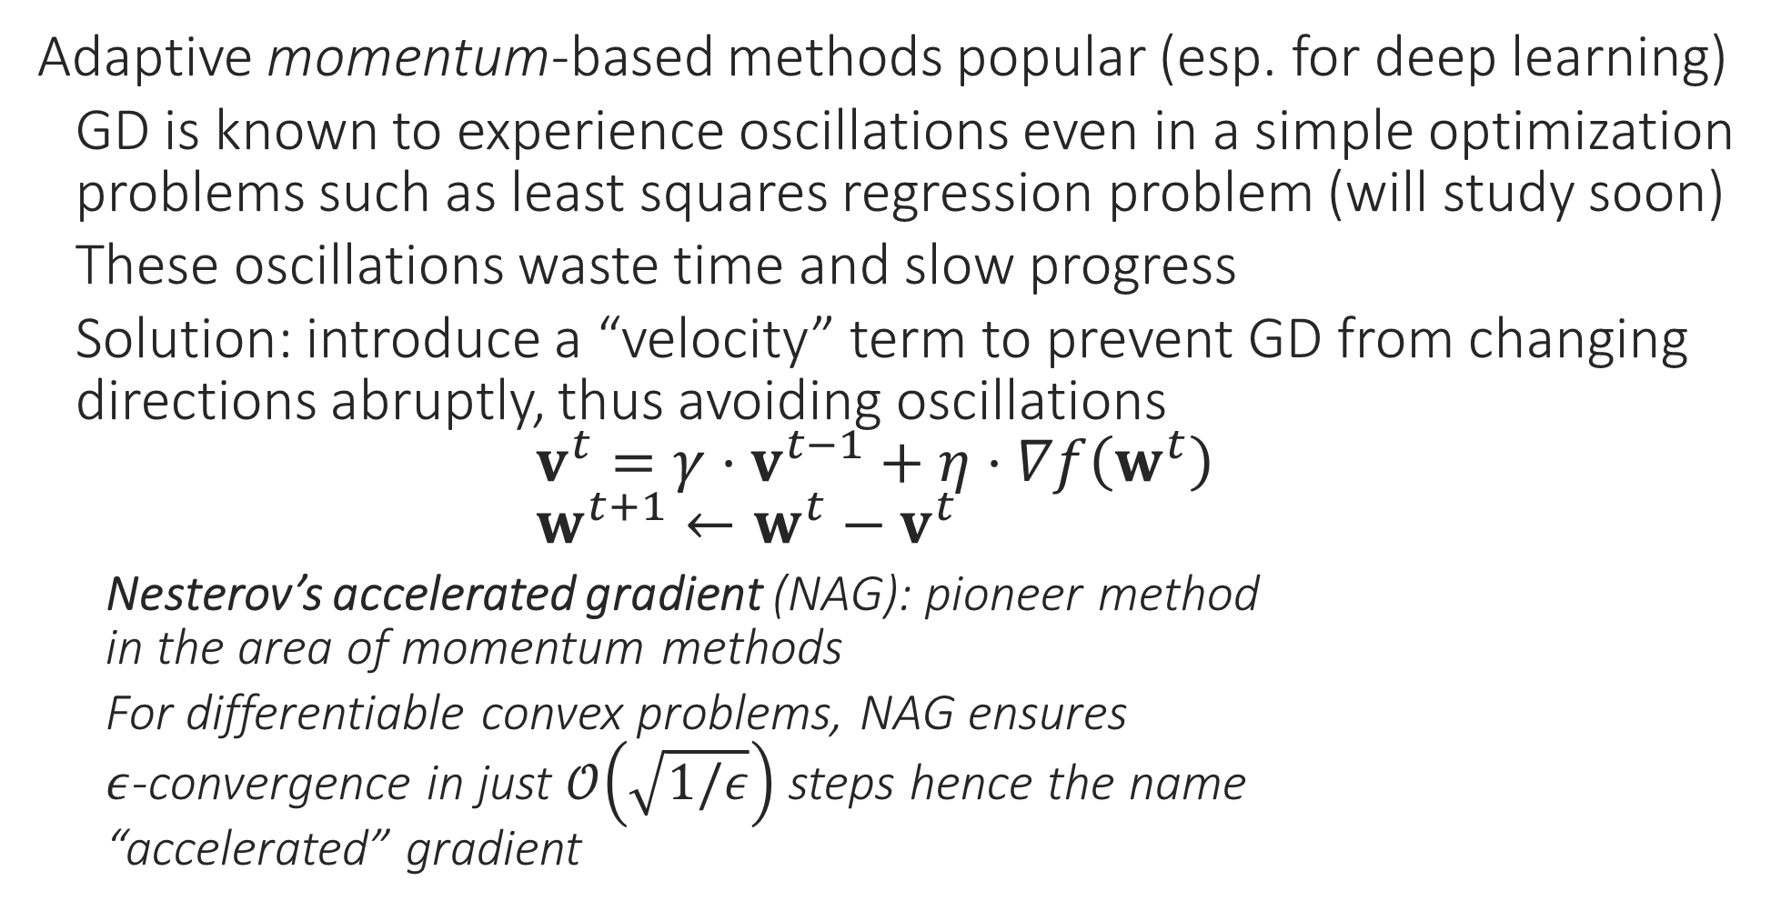
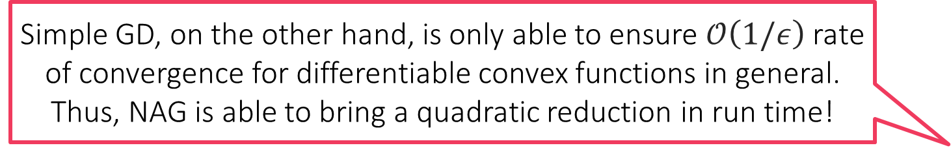
Adaptive Learning Rates
Adaptive momentum-based methods popular (esp. for deep learning)
GD is known to experience oscillations even in a simple optimization problems such as least squares regression problem (will study soon)
These oscillations waste time and slow progress
Solution: introduce a “velocity” term to prevent GD from changing directions abruptly, thus avoiding oscillations $v^{t}={γ⋅v}^{t−1}+η⋅∇f\left(w^{t}\right)$ $w^{t+1}←w^{t}−v^{t}$
Nesterov’s accelerated gradient (NAG): pioneer method in the area of momentum methods
For differentiable convex problems, NAG ensures $ε$-convergence in just $𝒪\left(\sqrt{1/ε}\right)$ steps hence the name “accelerated” gradient
Simple GD, on the other hand, is only able to ensure $𝒪\left(1/ε\right)$ rate of convergence for differentiable convex functions in general. Thus, NAG is able to bring a quadratic reduction in run time!

Slide 22
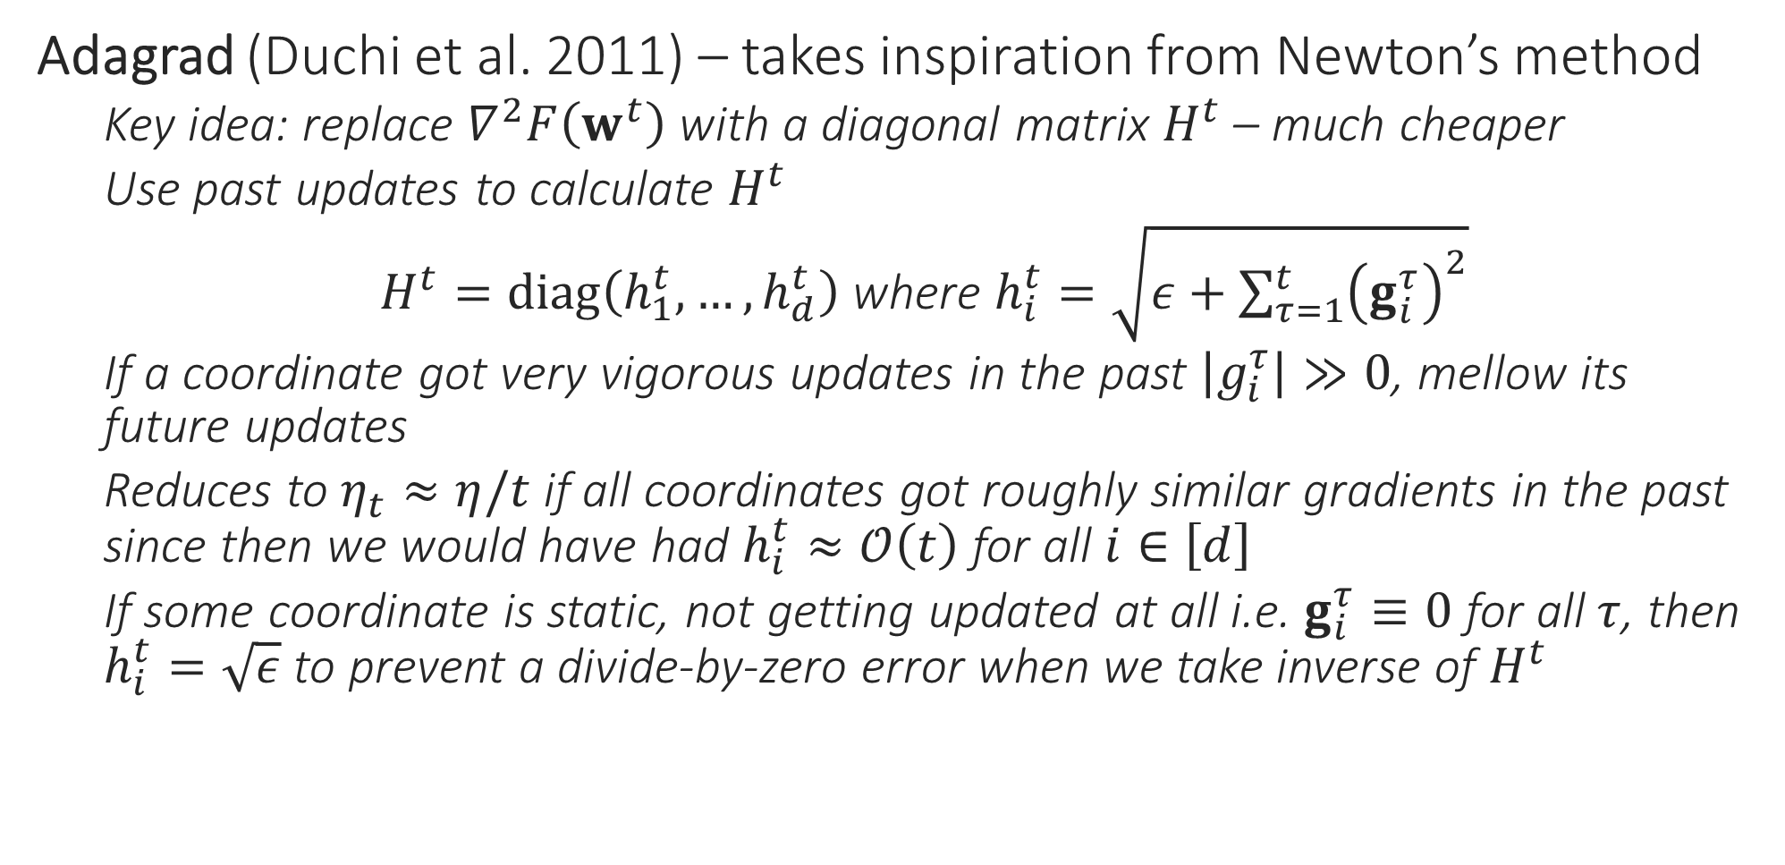
Adaptive Learning Rates
Adagrad (Duchi et al. 2011) – takes inspiration from Newton’s method
Key idea: replace $∇^{2}F\left(w^{t}\right)$ with a diagonal matrix $H^{t}$ – much cheaper
Use past updates to calculate $H^{t}$
$H^{t}=diag\left(h_{1}^{t}, …,h_{d}^{t}\right)$ where $h_{i}^{t}=\sqrt{ε+\sum_{τ=1}^{t}{{\left(g_{i}^{τ}\right)}^{2}}}$
If a coordinate got very vigorous updates in the past $\left|g_{i}^{τ}\right|≫0$, mellow its future updates
Reduces to $η_{t}≈η/t$ if all coordinates got roughly similar gradients in the past since then we would have had $h_{i}^{t}≈𝒪\left(t\right)$ for all $i∈\left[d\right]$
If some coordinate is static, not getting updated at all i.e. $g_{i}^{τ}≡0$ for all $τ$, then $h_{i}^{t}=\sqrt{ε}$ to prevent a divide-by-zero error when we take inverse of $H^{t}$

Slide 23
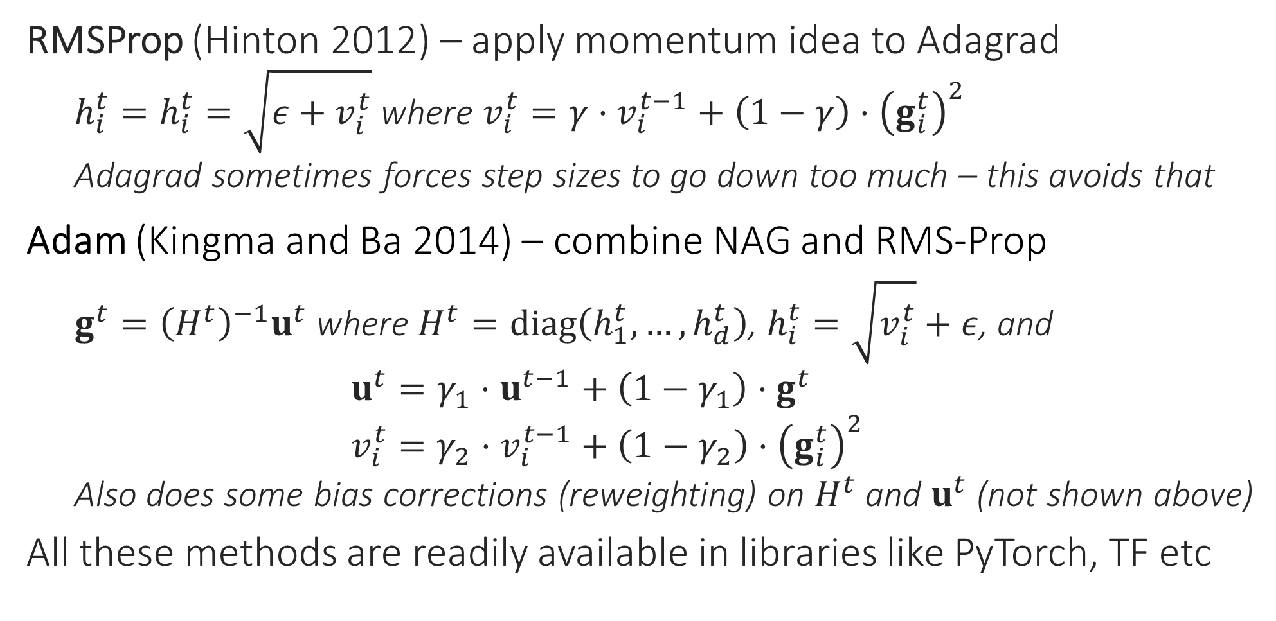
Adaptive Learning Rates
RMSProp (Hinton 2012) – apply momentum idea to Adagrad
$h_{i}^{t}=h_{i}^{t}=\sqrt{{ε+v}_{i}^{t}}$ where $v_{i}^{t}=γ⋅v_{i}^{t−1}+\left(1−γ\right)⋅{\left(g_{i}^{t}\right)}^{2}$
Adagrad sometimes forces step sizes to go down too much – this avoids that
Adam (Kingma and Ba 2014) – combine NAG and RMS-Prop
$g^{t}={\left(H^{t}\right)}^{−1}u^{t}$ where $H^{t}=diag\left(h_{1}^{t},…,h_{d}^{t}\right)$, $h_{i}^{t}=\sqrt{v_{i}^{t}}+ε$, and $u^{t}=γ_{1}⋅u^{t−1}+\left(1−γ_{1}\right)⋅g^{t}$ $v_{i}^{t}=γ_{2}⋅v_{i}^{t−1}+\left(1−γ_{2}\right)⋅{\left(g_{i}^{t}\right)}^{2}$
Also does some bias corrections (reweighting) on $H^{t}$ and $u^{t}$ (not shown above)
All these methods are readily available in libraries like PyTorch, TF etc

